Slide 1
Decoding Deception
Identifying SMS-Based Cyber Attacks
By: Vaibhav Magoo

Slide 2

Introduction
Impact of Text Attacks
What is Phishing
2. Data Preparation and Analysis
The Variables
EDA
TF-IDF
3. Model Performance
SVM
Neural Network
Comparisons
4. Conclusion
Optimising Possibilities
Business Applications and Suggestions

Slide 3
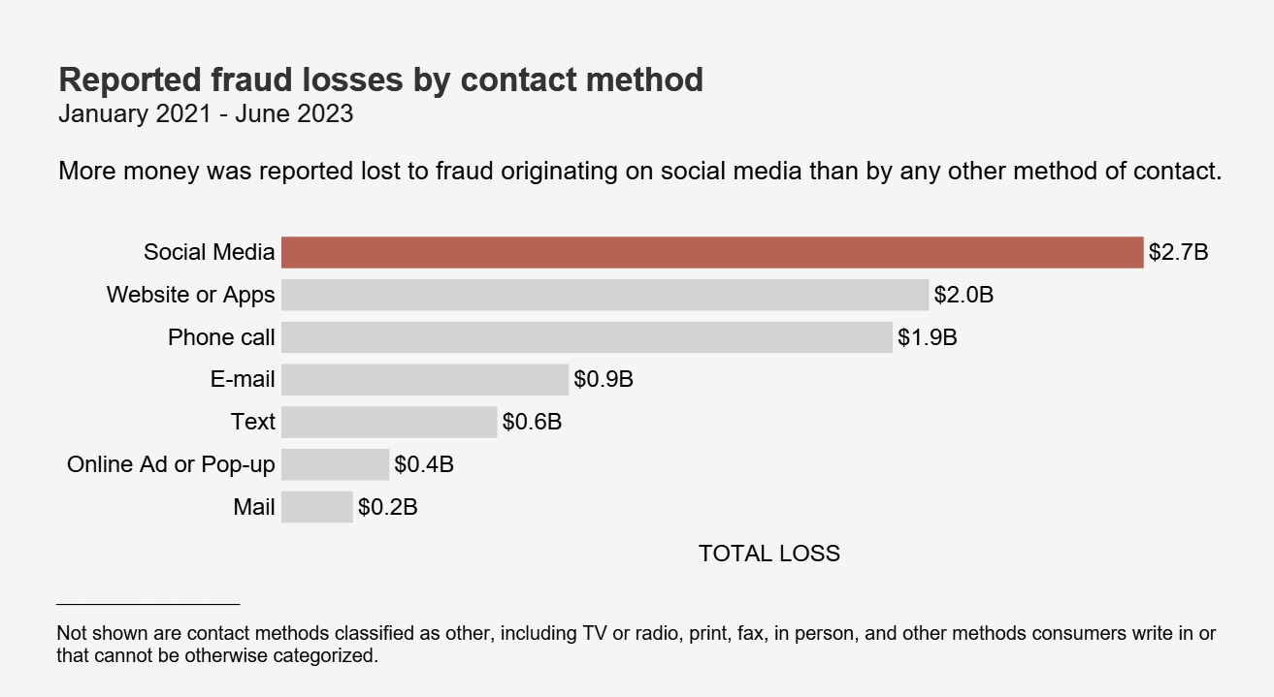
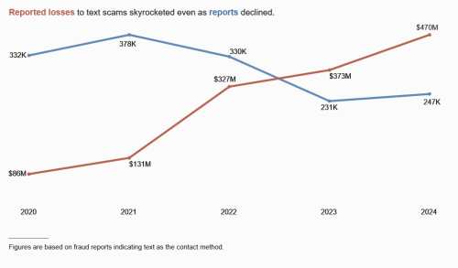
Impact of Text Attacks
FTC Reports
Text Fraud Breakdown
Changing Atmosphere
$12.5 billion in losses last year
$1,500 median to phone calls
372,000 reports of emails
Text fraud third most common
22% of all fraud reports
$1000 median loss
Text losses on the rise
Scams evolving?

Slide 4

What is Phishing?
Phishing is a cyber attack where attackers trick people into revealing sensitive information
(like passwords, credit card numbers, or login credentials).
Typically delivered via email, text message (smishing), or fake websites.
Often uses spoofed identities
(e.g., posing as a bank, company, or government agency).
The goal is to steal data or credentials, not always immediate money.
Scams are broader schemes that involve phishing but not always

Slide 5
The Variables
LABEL (DV)
EMAIL
Three Categories
Smishing
Spam
Ham
Binary Variable indicating if an email address is present in the text message
PHONE
URL
Binary variable indicating if a phone number is present in the text message
Binary variable indicating if a URL is present in the text message

Slide 6
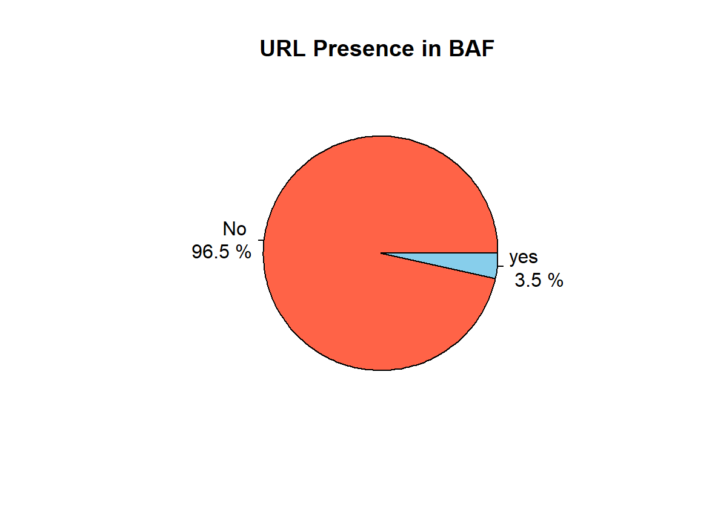
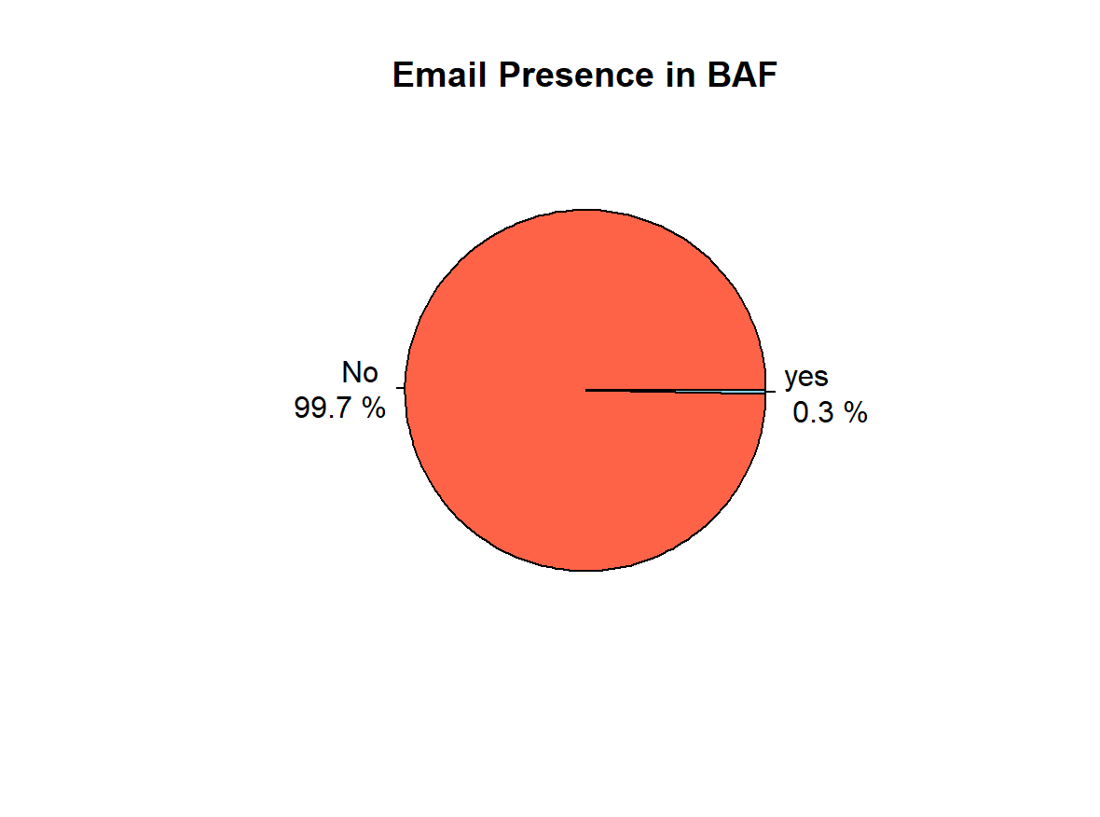
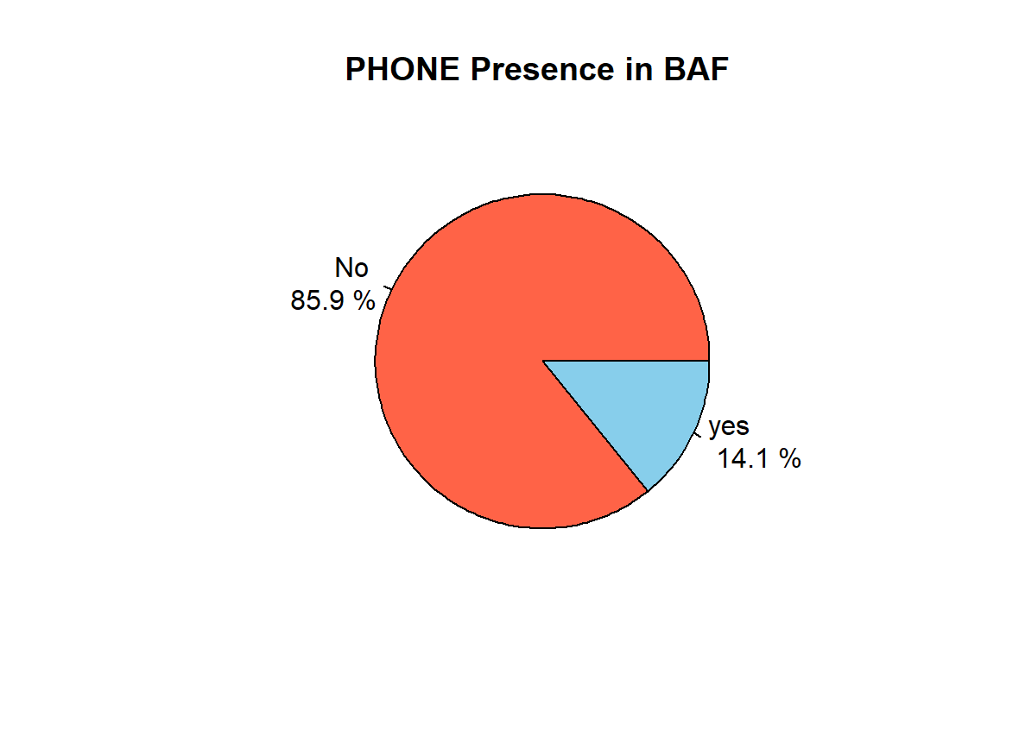
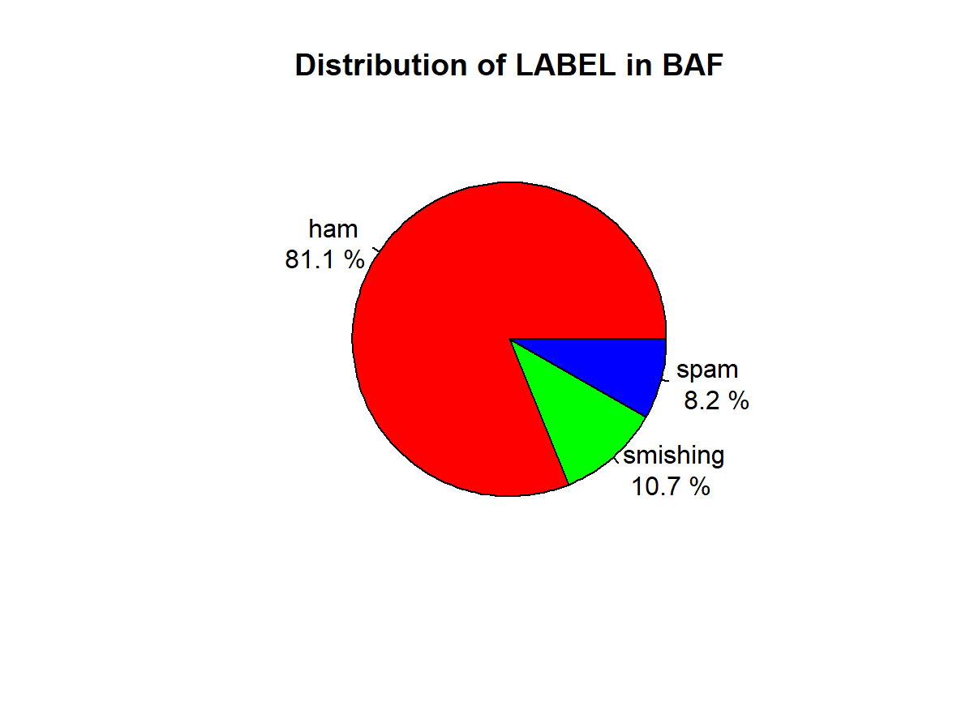
Univariate
EDA
Most messages in the dataset are legitimate (ham-81.1%), but a notable portion are scams.
Scam-related features like phone numbers (14.1%) and URLs (3.5%) are present in only a small fraction of messages.
Email addresses (0.3%) are almost never used in SMS, making them ineffective for fraud detection.
Even rare features like URLs and phone numbers can help flag suspicious messages when they do appear.

Slide 7
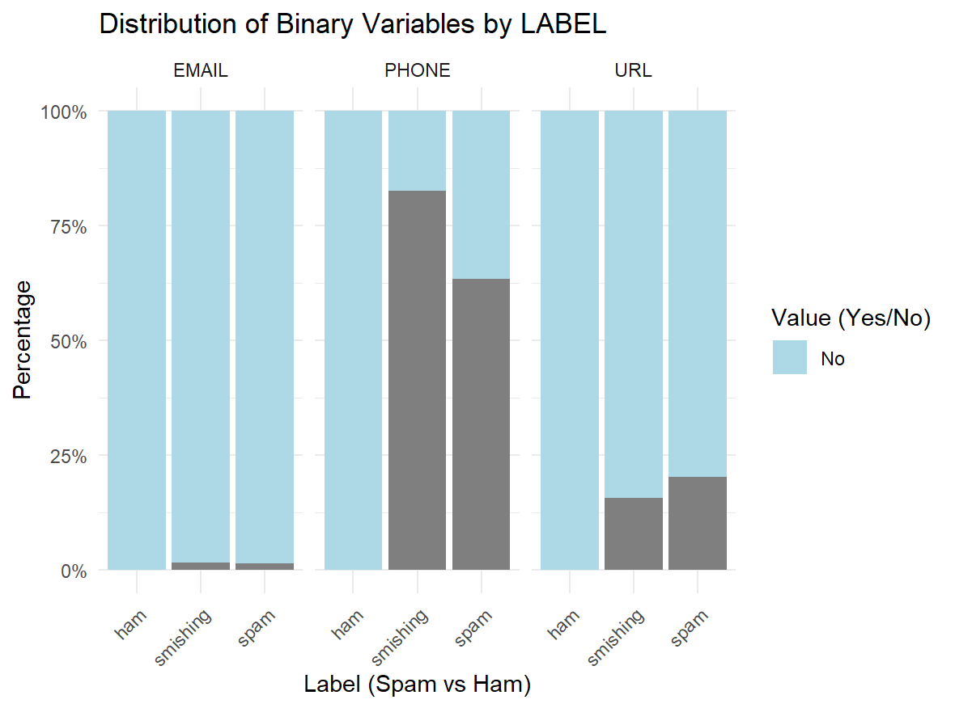
Bivariate
EDA
Scam texts often include phone numbers or links, over 60% of smishing and spam messages had them.
In contrast, normal texts (ham) almost never contain links or phone numbers.
Email addresses were rare in all types; not a strong scam signal.
Just like a fake message saying “Call this number to verify your account”.
These patterns help our model spot suspicious texts by structure, not just wording.

Slide 8
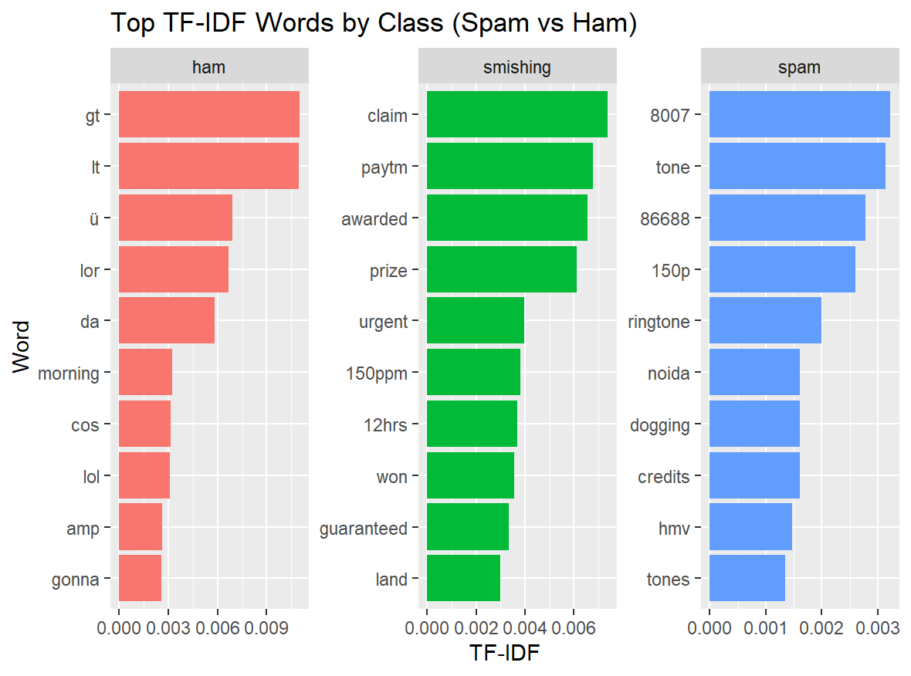
TF-IDF
Smishing texts use trigger words like “claim”, “urgent”, and “prize”, exposing scam intent.
Ham messages feature casual, harmless terms like “lol” and “gonna”.
Spam is marked by promotional terms like “ringtone” and “150p”.
TF-IDF helped models detect deceptive patterns by highlighting class-specific language.

Slide 9
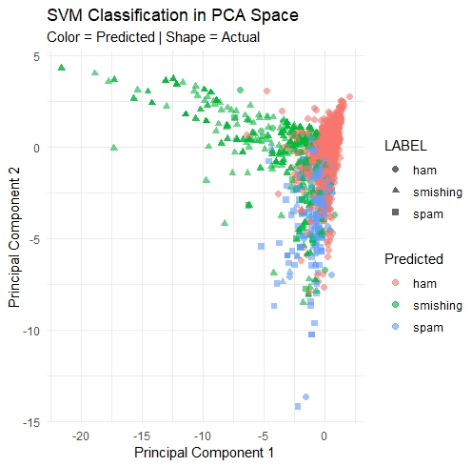
Support Vector Machine
Precision Recall F1
Class: ham 0.9278049 0.9824380 0.9543402
Class: smishing 0.8484848 0.6614173 0.7433628
Class: spam 0.6617647 0.4639175 0.5454545
Achieved 90.6% accuracy, with strong ham detection (F1: 0.95).
Smishing precision is 84.8%, but recall is lower (66.1%), some scams are missed.
PCA plot shows ham is well separated, while smishing overlaps with ham and spam.
Highlights how fraudsters mimic normal texts, making detection challenging.

Slide 10
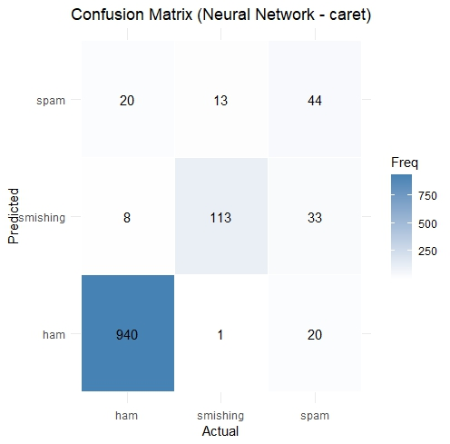
Neural Network
Precision Recall F1
Class: ham 0.9781478 0.9710744 0.9745982
Class: smishing 0.7337662 0.8897638 0.8042705
Class: spam 0.5714286 0.4536082 0.5057471
Neural networks are effective at learning complex scam cues hidden in everyday messages.
Achieved 92.0% accuracy, indicating strong potential for real-world fraud filtering.
Smishing recall: 88.9% , the model successfully detects most scam messages.
High F1 (80.4%) for smishing means it balances scam detection with minimal false alarms.
Misclassifications mostly occurred with spam, showing scammers may mimic promotional tone.
Smishing emerged as the most targeted fraud tactic based on frequency and detection.
Results show fraudsters often exploit SMS language patterns to bypass traditional filters.

Slide 11
Model Comparison
Neural Network adapts better to new scam patterns, ideal for dynamic fraud environments.
Neural Net can handle nonlinear relationships, capturing subtle fraud signals in text.
Neural Network scales better with larger datasets and richer feature sets (like message metadata).
Neural Net had higher recall for smishing, reducing the risk of missed scam messages.
VS
SVM is more interpretable, making it easier to understand why a message was flagged.
SVM trains faster and requires fewer computational resources, suitable for low-power systems.
SVM may underperform in detecting complex language tricks used in sophisticated cyber frauds.
SVM performed better on spam, but struggled more with smishing misclassification.

Slide 12
Optimization Possibilities
Feature Engineering
Neural Network Architecture
Model Evaluation Enhancements
Include additional text features:
Message length, character counts, number of capital letters.
Presence of suspicious keywords (e.g., “win,” “urgent”).
Add more neurons or hidden layers (use keras for flexibility).
Experiment with ReLU activation or dropout layers to reduce overfitting.
Use ROC-AUC for each class.
Perform stratified k-fold cross validation for stability.
Track training time and resource usage for deployment.

Slide 13
Business Applications and Suggestions
Fraud Prevention
Integration with Enterprise Tools
Use case: Automatically flag and filter smishing and spam messages in telecom or banking.
Value: Helps prevent identity theft, scams, and financial losses.
Deploy models into:
Email/SMS gateways
CRM systems for fraud alerts
Mobile apps for real-time message scoring

Slide 14
Q and A

